Slide 1

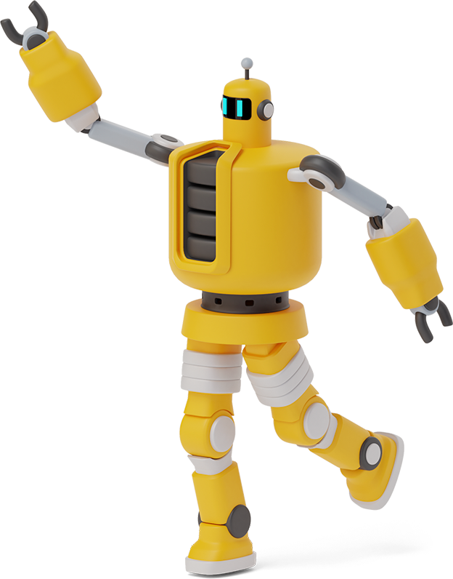
CUSTOMER CARE REGISTRY
Literature Survey

Slide 2
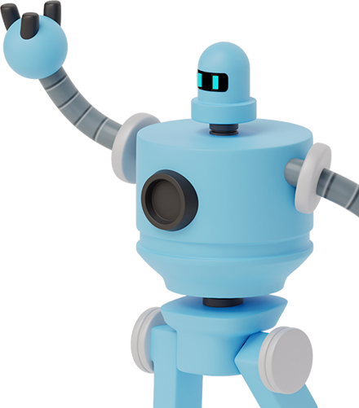
TEAM DETAILS
Team No : PNT2022TMID10794
College Name: IFET College of Engineering
Department : Electronic and communication Engineering
TEAM MEMBERS
VIGNESH D
YOGIRAMAN S
VIJAY K
HARSHAD SAI VENKAT
UDHAYANITHI

Slide 3
PROJECT DESIGN PHASE - 1
PROPOSED SOLUTION
DATE | 8 November 2022
TEAM ID | PNT2022TMID10794
PROJECT NAME | CUSTOMER CARE REGISTRY
MAXIMUM MARKS | 2 Marks

Slide 4
LITERATURE SURVEY
Title | PROPOSED WORK | TOOLS USED | TECHNOLOGY | MERIT & DEMERIT
REAL WORLS SMART CHATBOT FOR CUSTOMER CARE USING SAAS ARCHITECTURE | This paper deploys a chatbot from AWS cloud for customer care . This is done to provide human using LUIS and cognitive services. | AWS Public service API Gateway LUIS Ejabberd chatbot | Cloud Computing Machine learning | This provides a robust , scalable architecture with Ejabberd server. The Ejabberd server takes longer time to respond to the request

Slide 5
LITERATURE SURVEY
Title | PROPOSED WORK | TOOLS USED | TECHNOLOGY | MERIT & DEMERIT
ARTIFICIAL INTELLIGENCE REPLACING HUMAN CUSTOMER SERVICE | This paper deploy the chatbots for customer service . It uses the AI to take decision making and provide service . | Chatbot Python MongoDB | Cloud Computing AI/ML | This take decision based upon the query by customer and replay with efficient

Slide 6
LITERATURE SURVEY
Title | PROPOSED WORK | TOOLS USED | TECHNOLOGY | MERIT & DEMERIT
CHATBOT FOR CUSTOMER SERVICE | In this paper the customer provide the asked info to the chatbot based on the data it provide the customer service | Chatbot HTML CSS Javascript | Cloud Computing AI/ML | This proposed model provide the customer service by use of clous

Slide 7
LITERATURE SURVEY
S.NO.& Title | PROPOSED WORK | TOOLS USED | TECHNOLOGY | MERIT & DEMERIT
AN INTELLIGENTCLOUD BASED CUSTOMER RELATIONSHIP MANAGEMENT SYSTEM TO DETERMINE FLEXIBLE PRICING FOR CUSTOMER RETENTION | This paper proposes the behaviour of the customer by analyzing the history pattern and use it for promotion | Intelligent cloud customer relation Management | Cloud Computing AI | The customer purchase pattern are analysed and used for the promotion of the products.

Slide 8

THANK
YOU

